Slide 1
Pathway and Gene Set Enrichment Analysis
Parveen Kumar

Slide 2
Gene Set Enrichment Analysis
Pathway Enrichment Analysis
Gene Ontology
Gene Set Enrichment Analysis

Slide 3
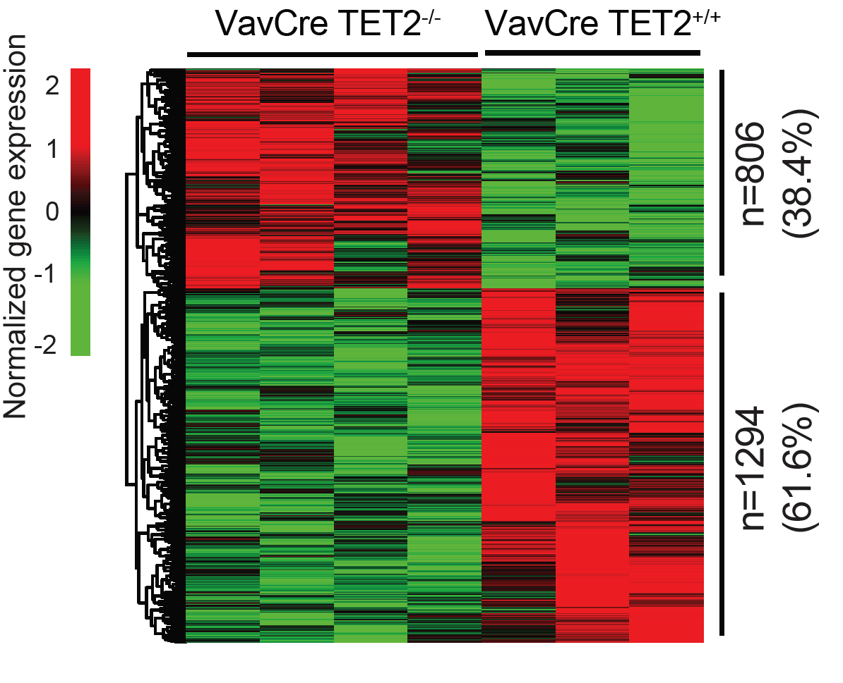
Pathway Enrichment Analysis
?
What pathways in enriched in these DGEs?
Heatmap of Differential Genes (DGEs)

Slide 4
Why do we need pathway information?
Understand the biological phenomena involved
To understand the gene network (Genes do not work alone, but in an intricate network of interactions)
In-depth and contextualized findings to help understand the mechanisms of disease in question
Prediction of drug targets
Understand how to intervene therapeutically in disease processes
Conduct targeted literature searches

Slide 5
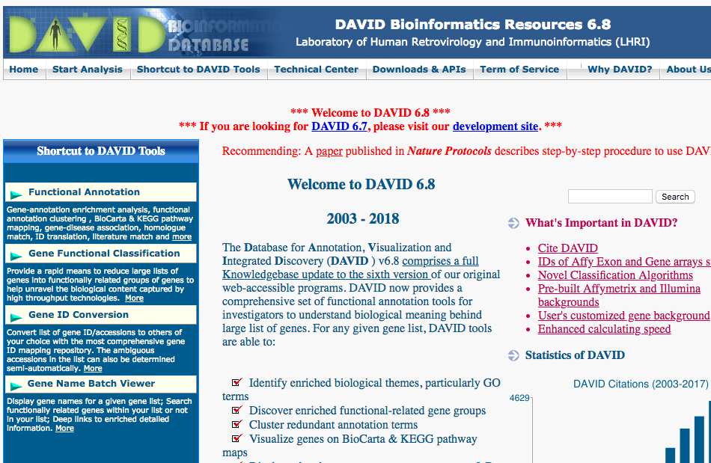
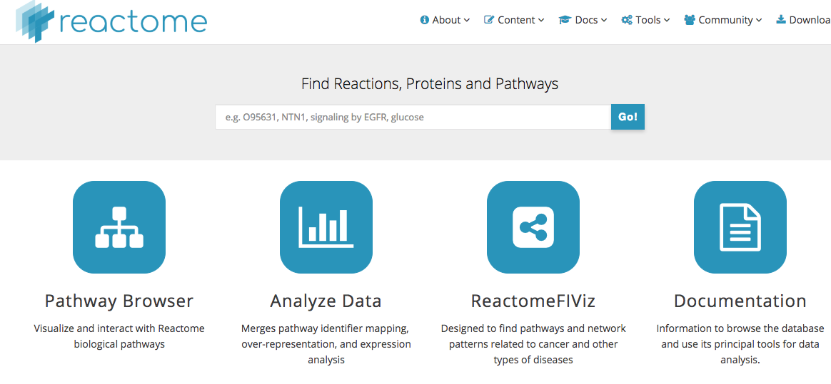
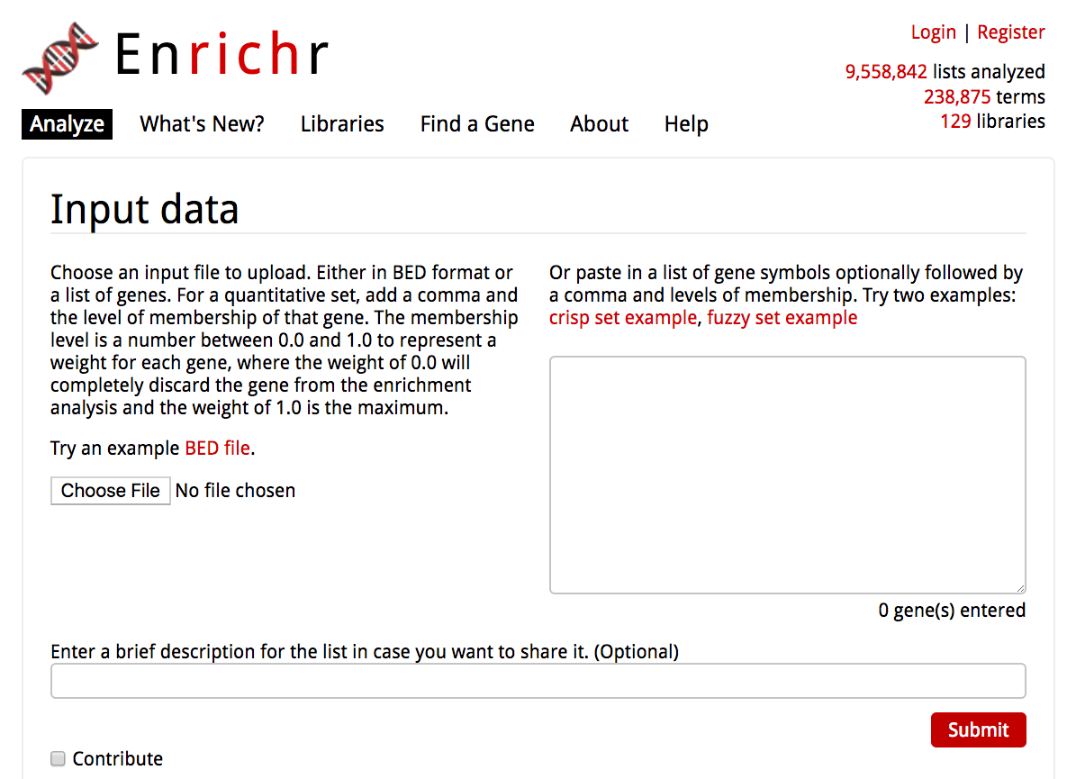
Online Tools
DAVID
https://david.ncifcrf.gov/home.jsp
Reactome
https://reactome.org/
Enrichr
http://amp.pharm.mssm.edu/Enrichr/

Slide 6
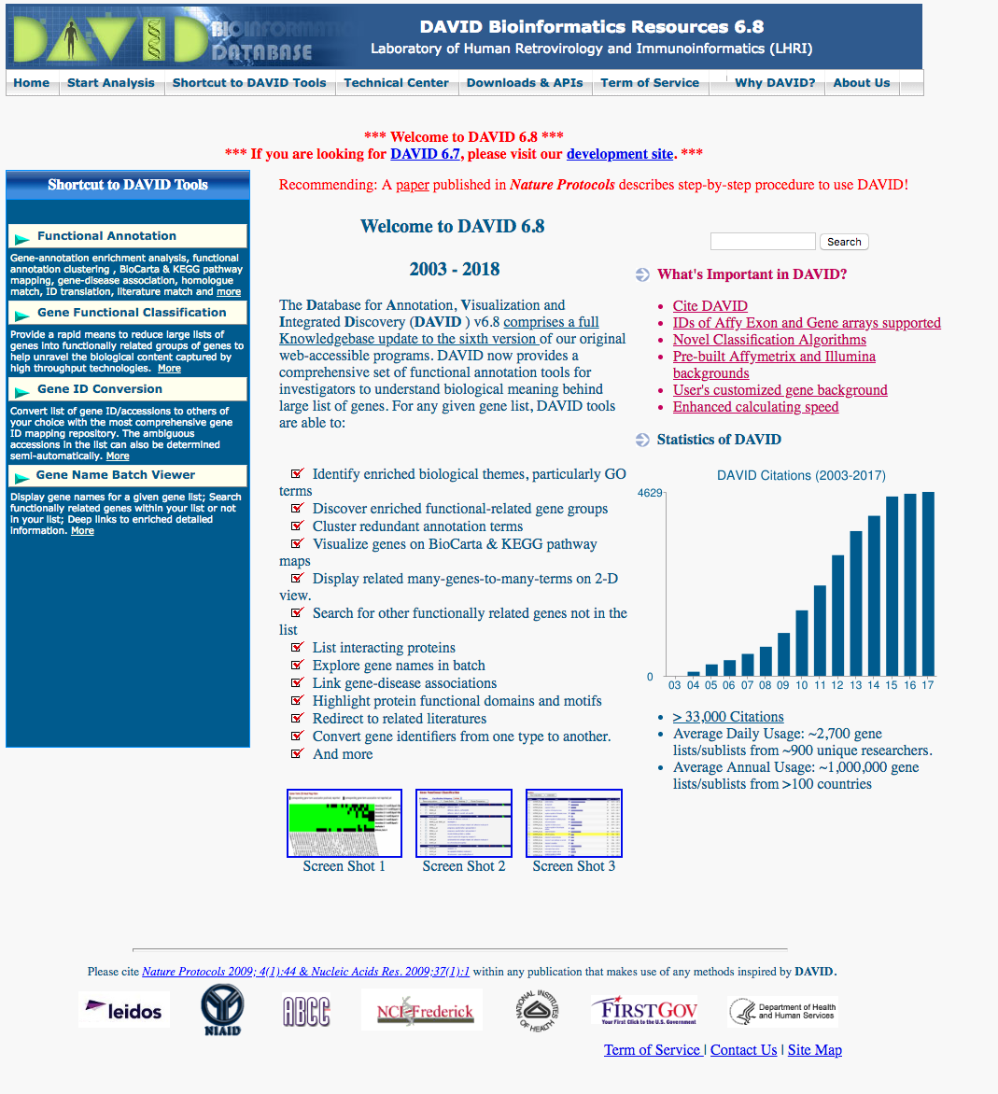
DAVID Tool for Functional Annotation

Slide 7
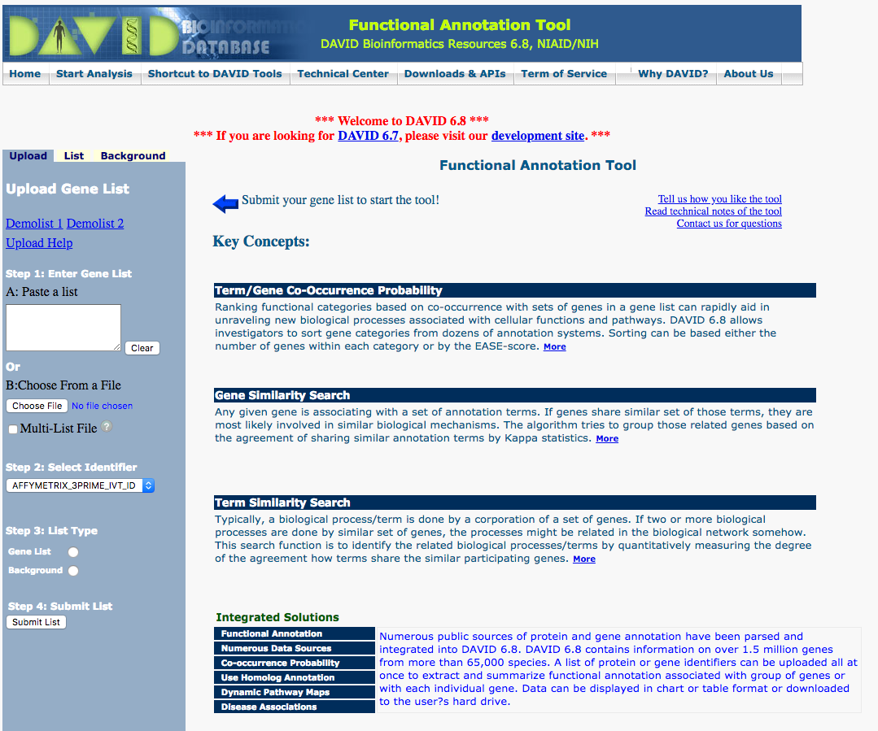
DAVID: Submitting Gene List
Paste Gene list
Choose gene list
E.g. Official Gene Symbol
Select List Type
e.g. Gene List

Slide 8
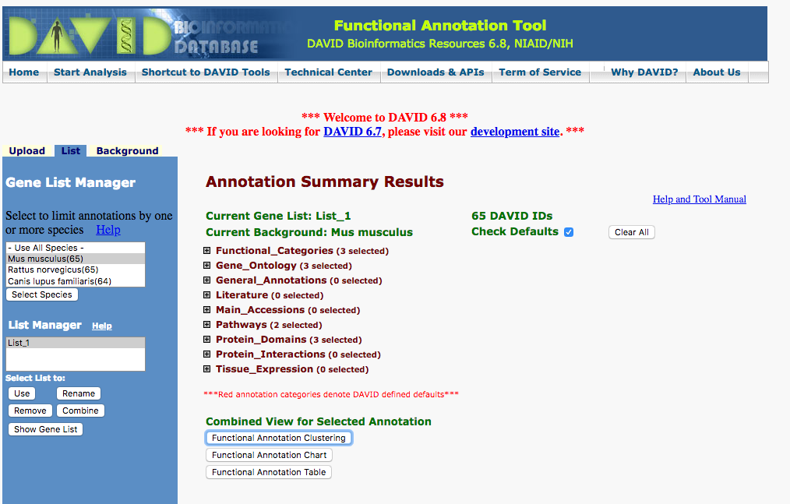
DAVID: Select Species and View results
Select Species
e.g. Mouse

Slide 9
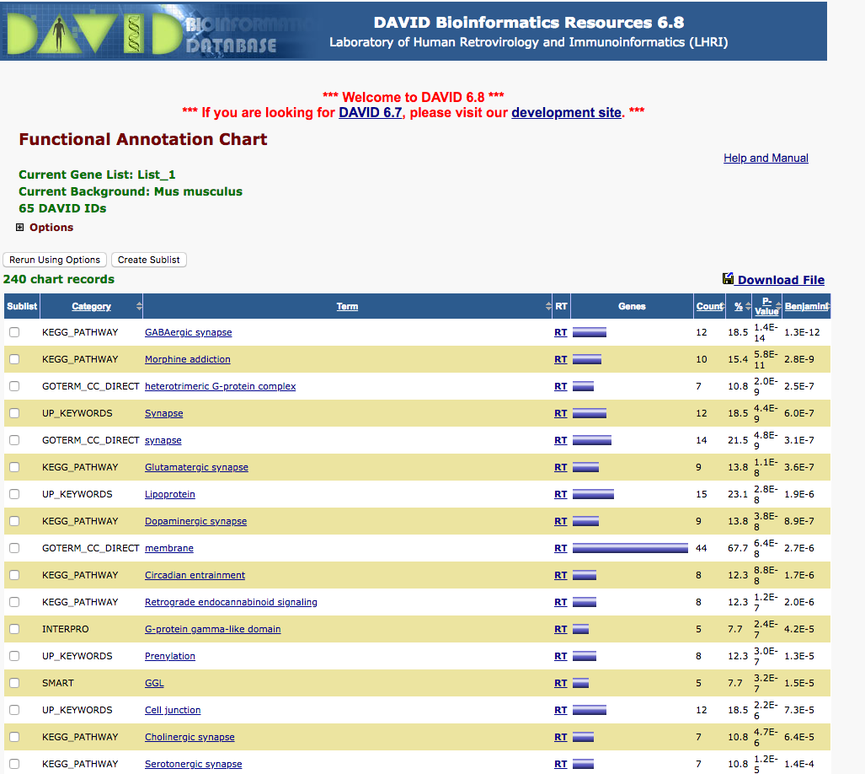
DAVID: Functional Annotation Chart

Slide 10
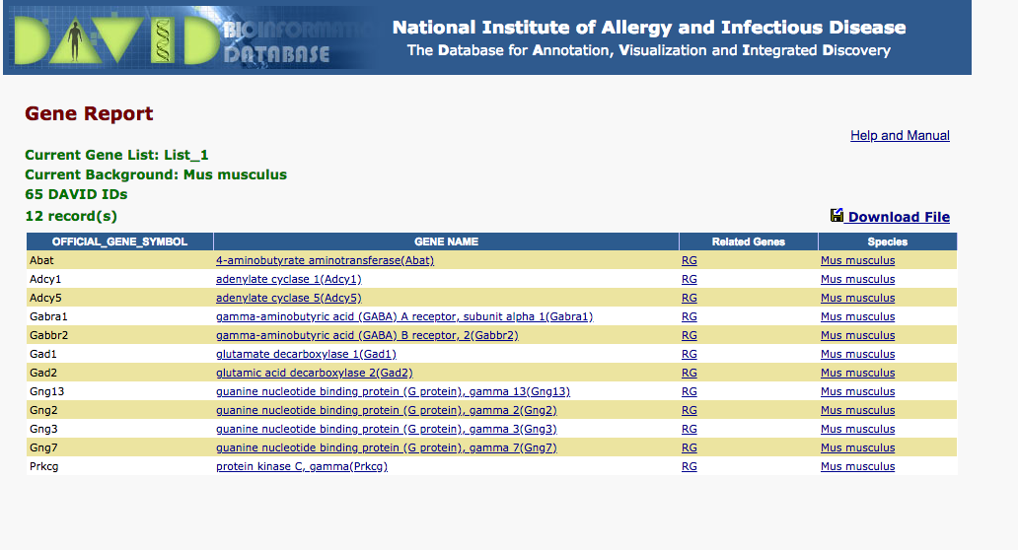
DAVID: Enriched Genes

Slide 11
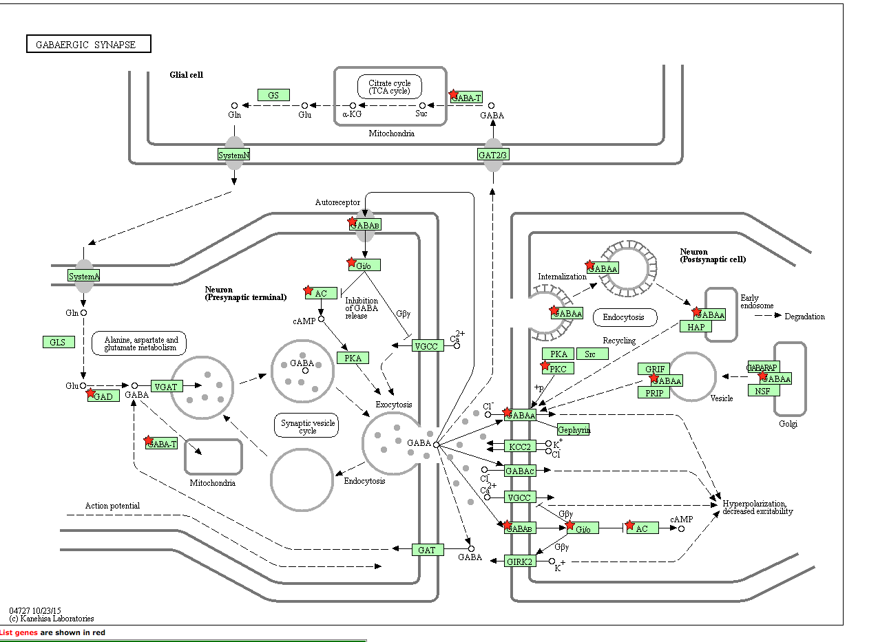
DAVID: Visualize genes in the enriched pathways

Slide 12
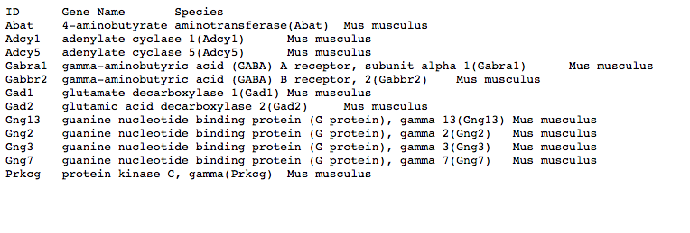
DAVID: Download gene lists

Slide 13
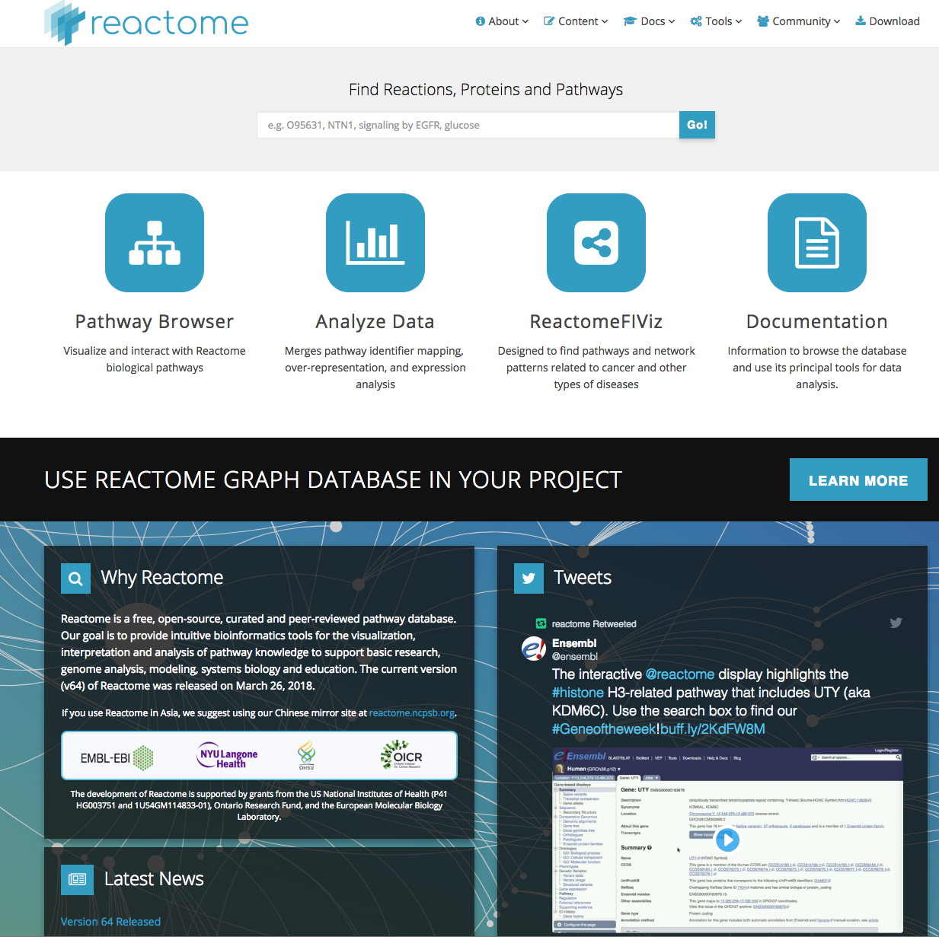
Reactome

Slide 14
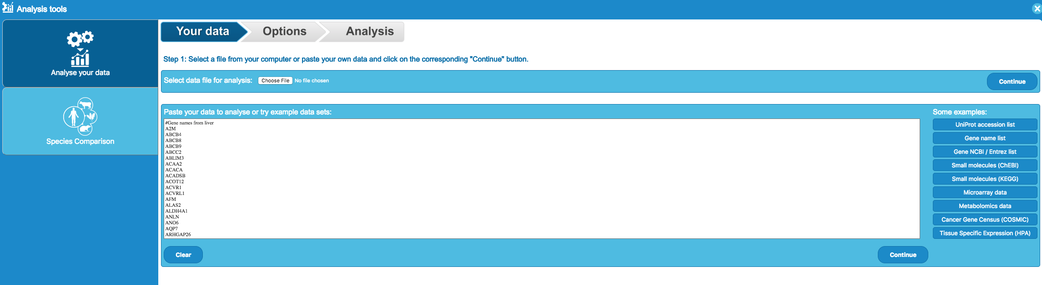
Reactome: Submit Gene List

Slide 15
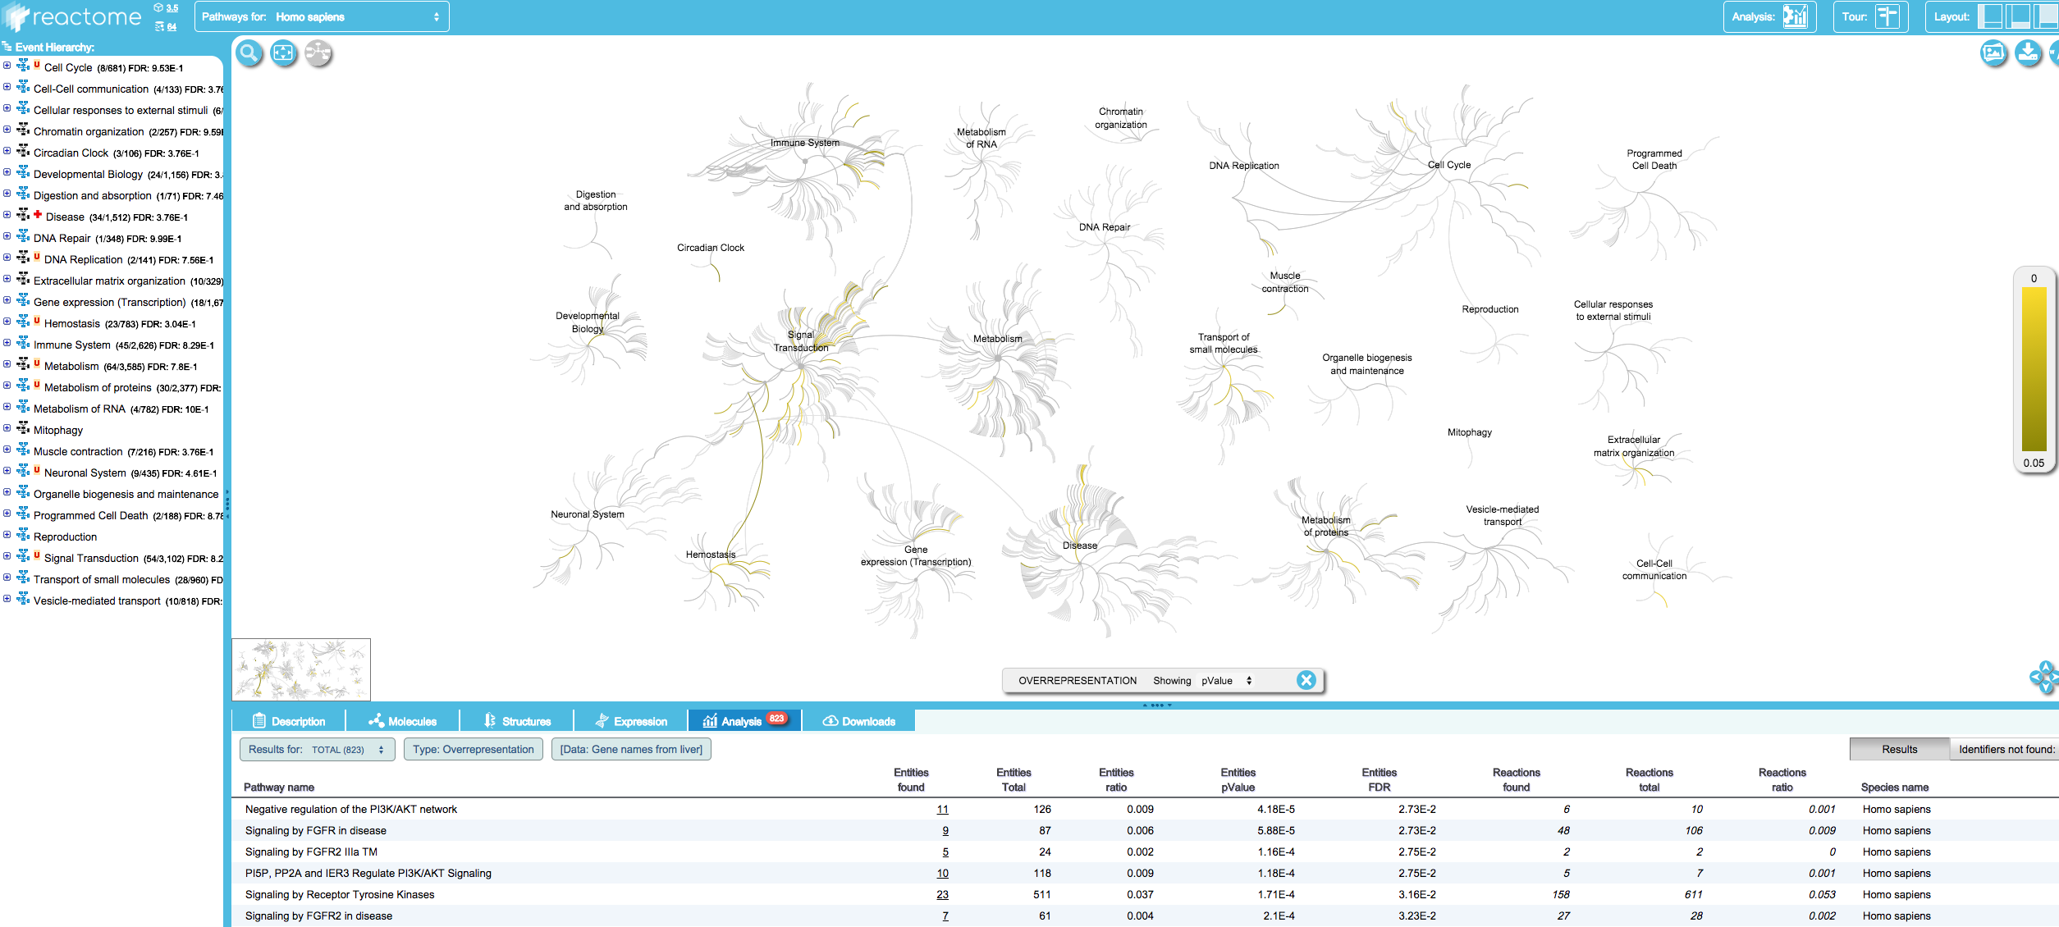
Reactome: Analyze Results

Slide 16
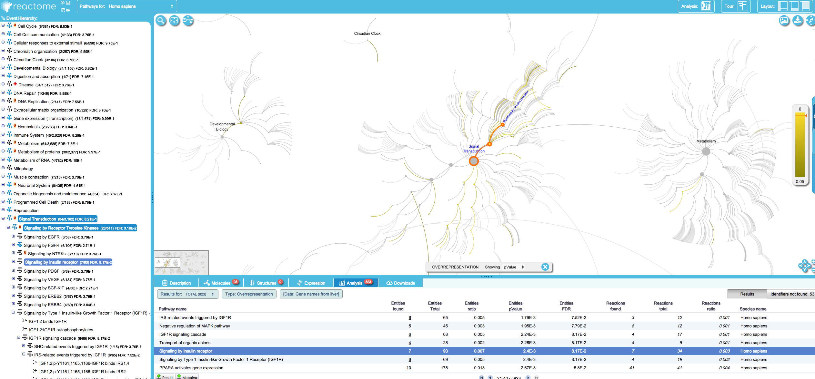
Reactome: Select specific pathway e.g. Insulin receptor

Slide 17
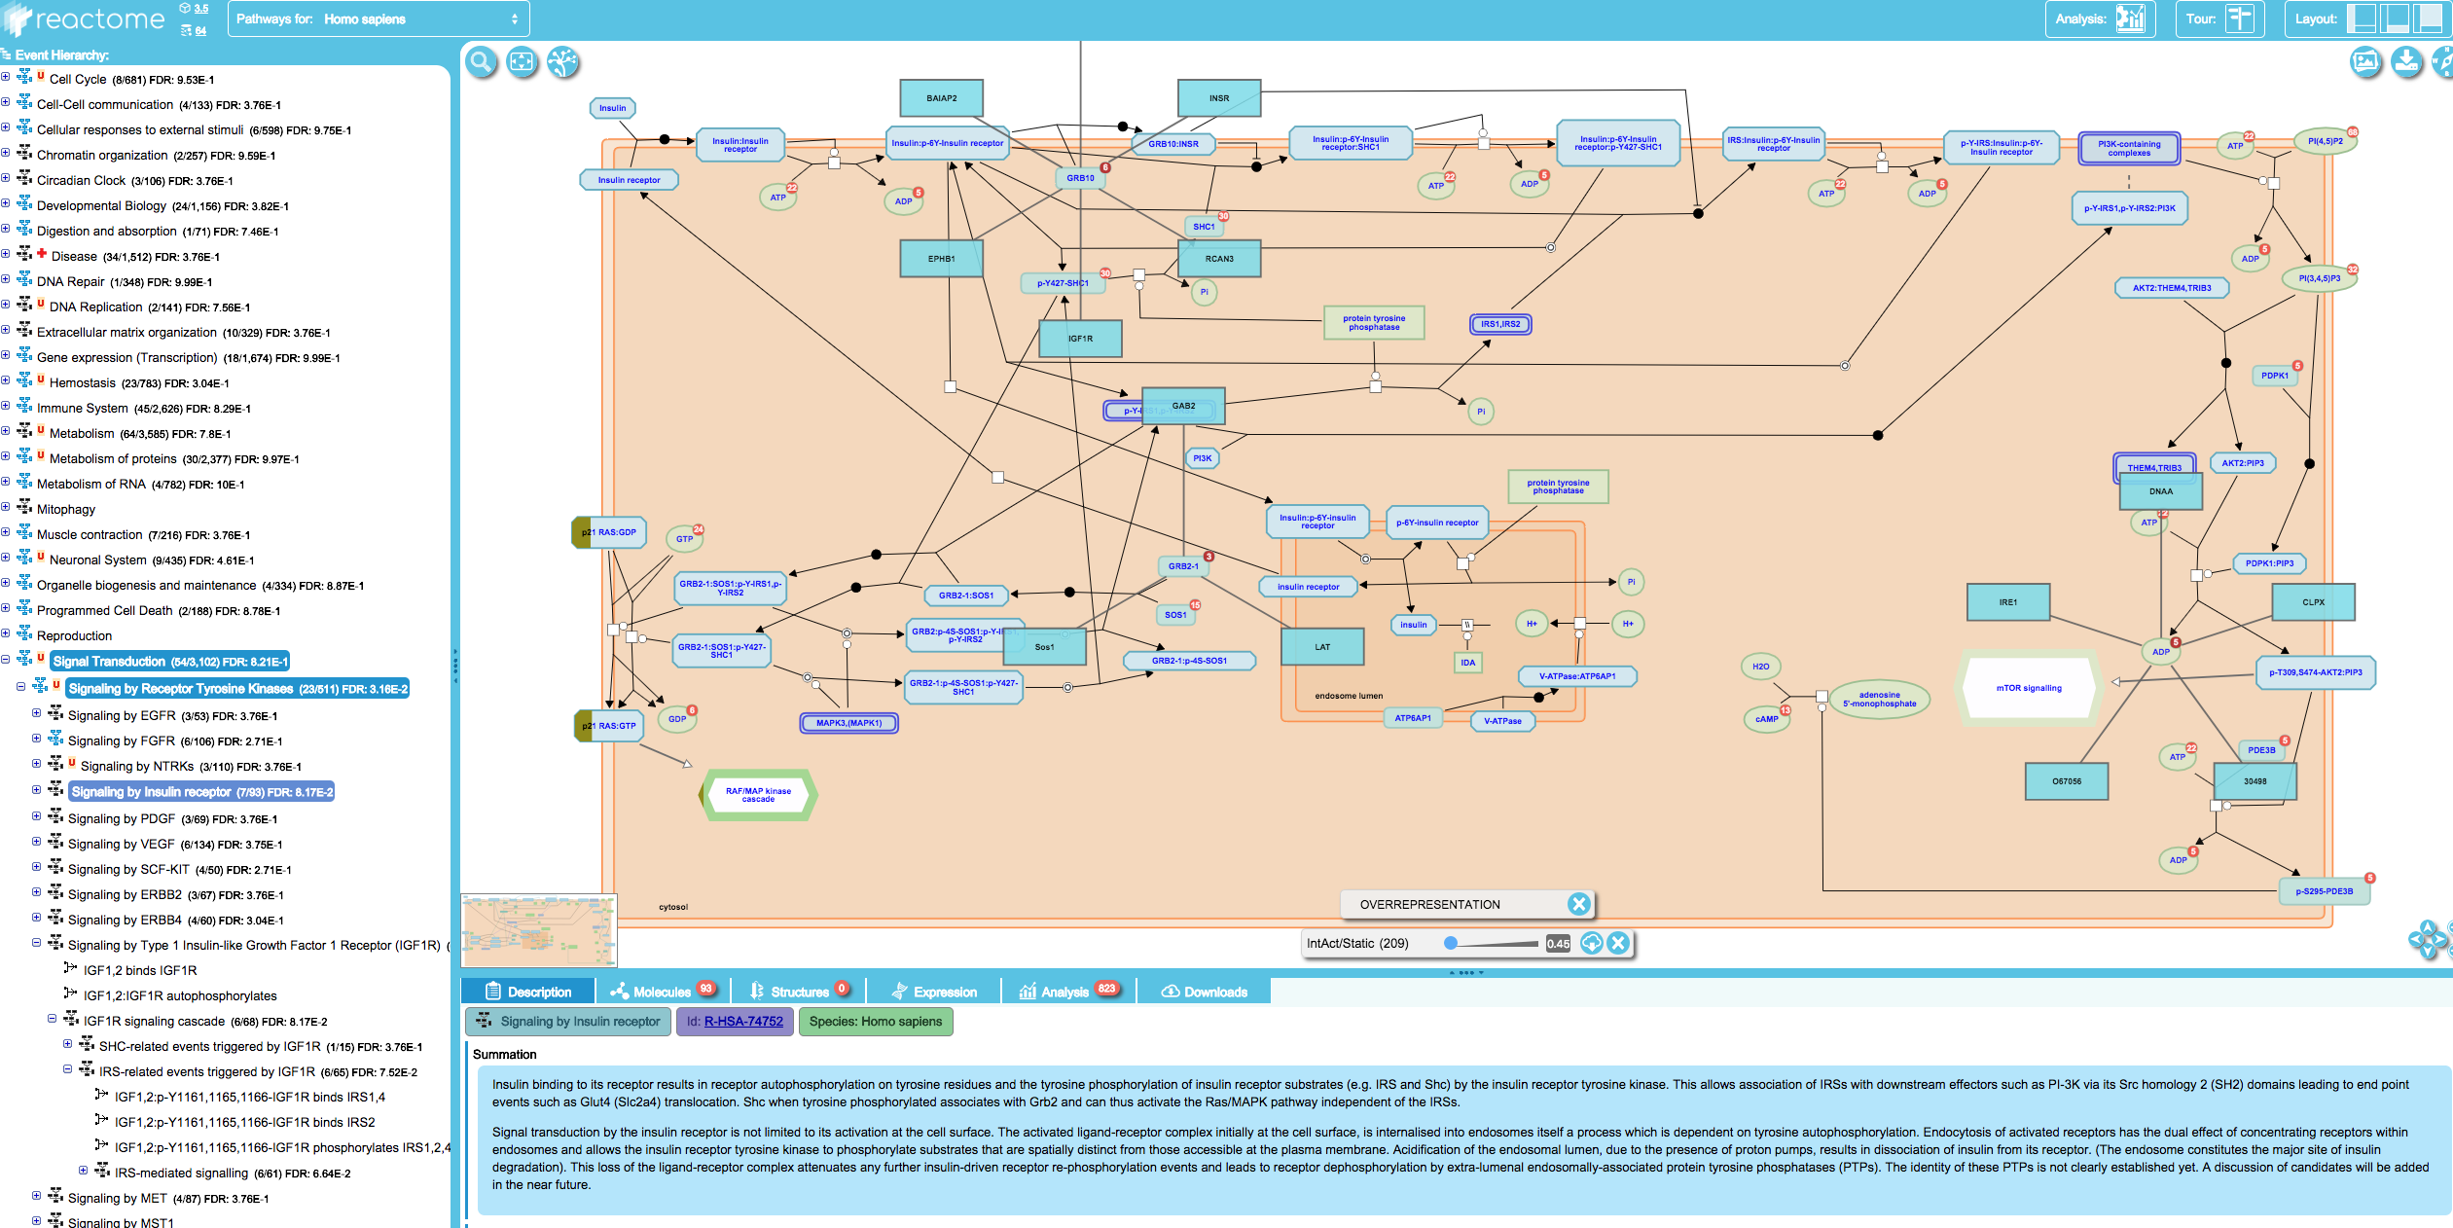
Reactome: Pathway Details

Slide 18
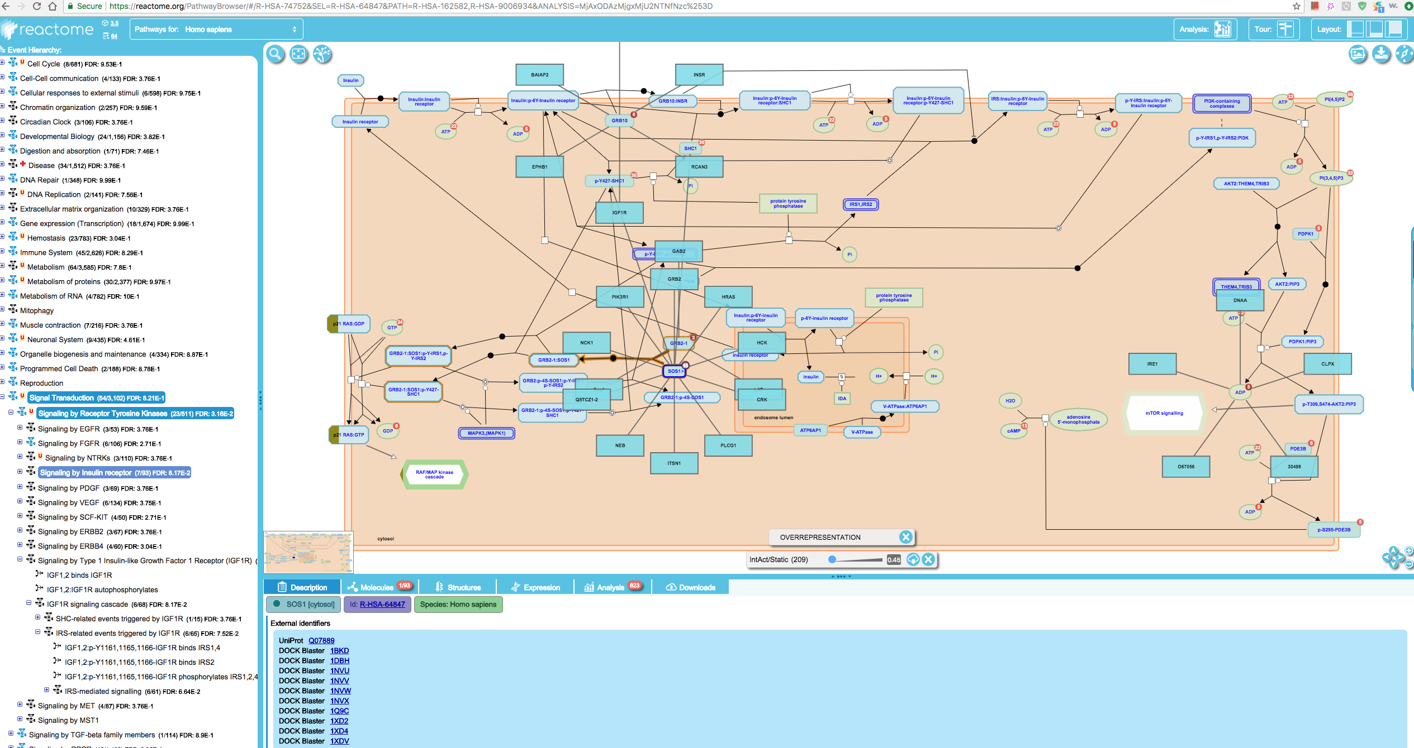
Reactome: Pathway Details

Slide 19
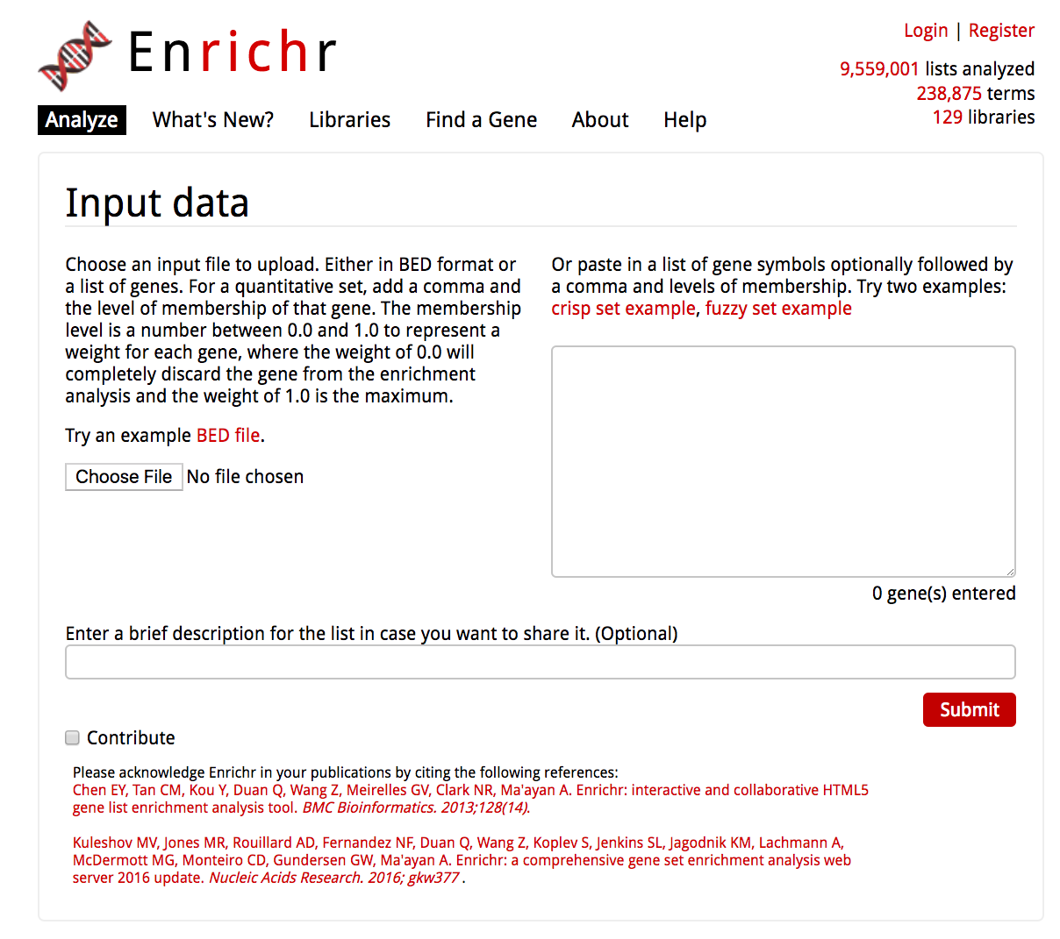
Enrichr

Slide 20
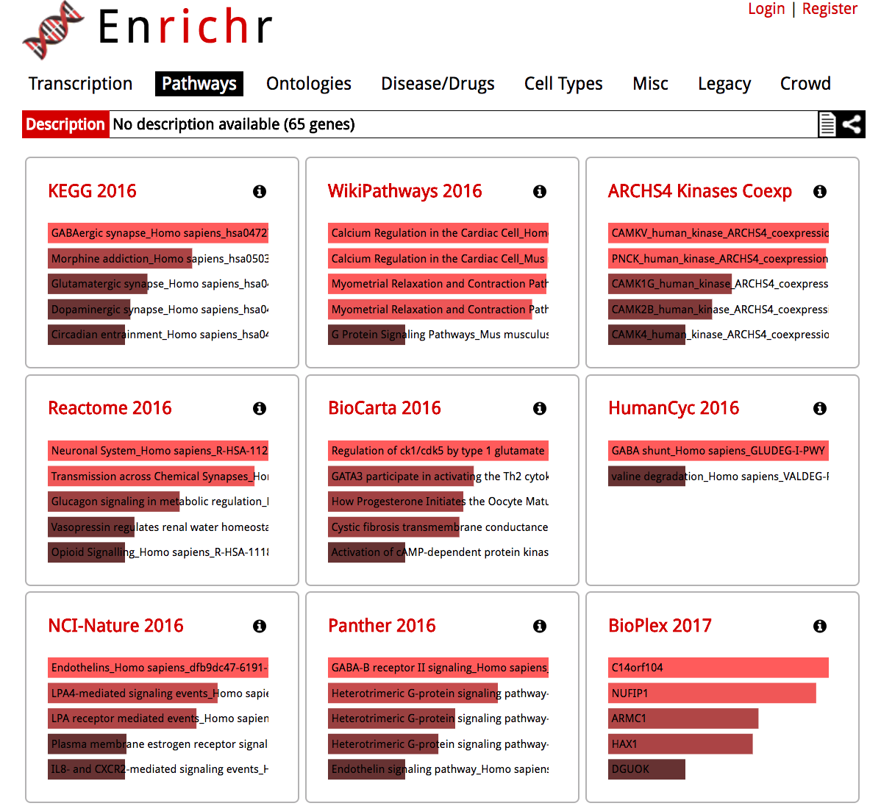
Enrichr

Slide 21
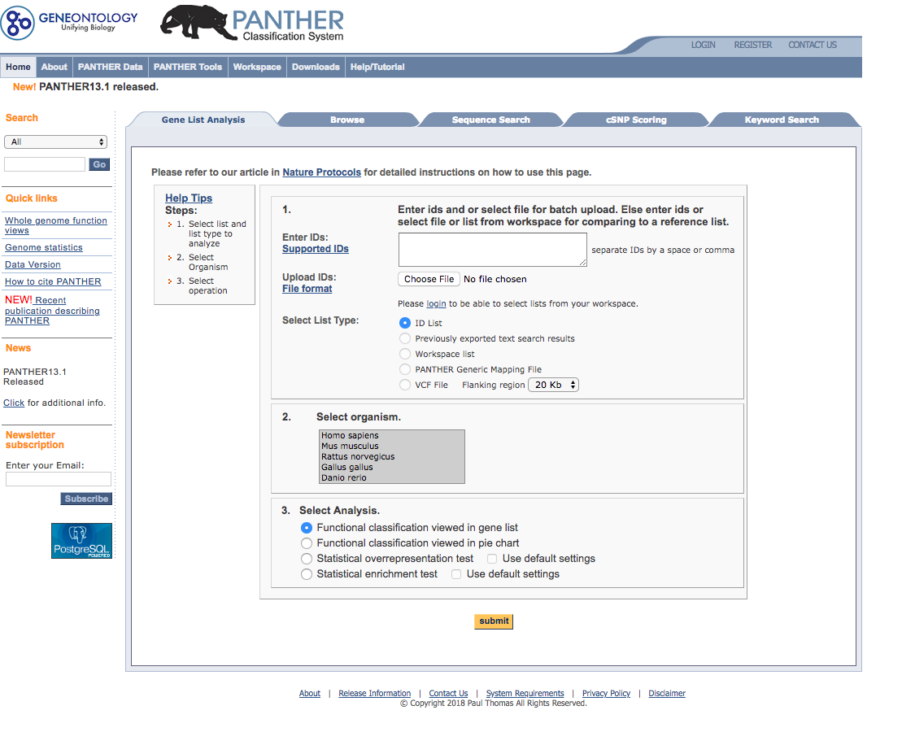
Gene Ontology
Enrichr
http://amp.pharm.mssm.edu/Enrichr/
Panther
http://www.pantherdb.org/

Slide 22
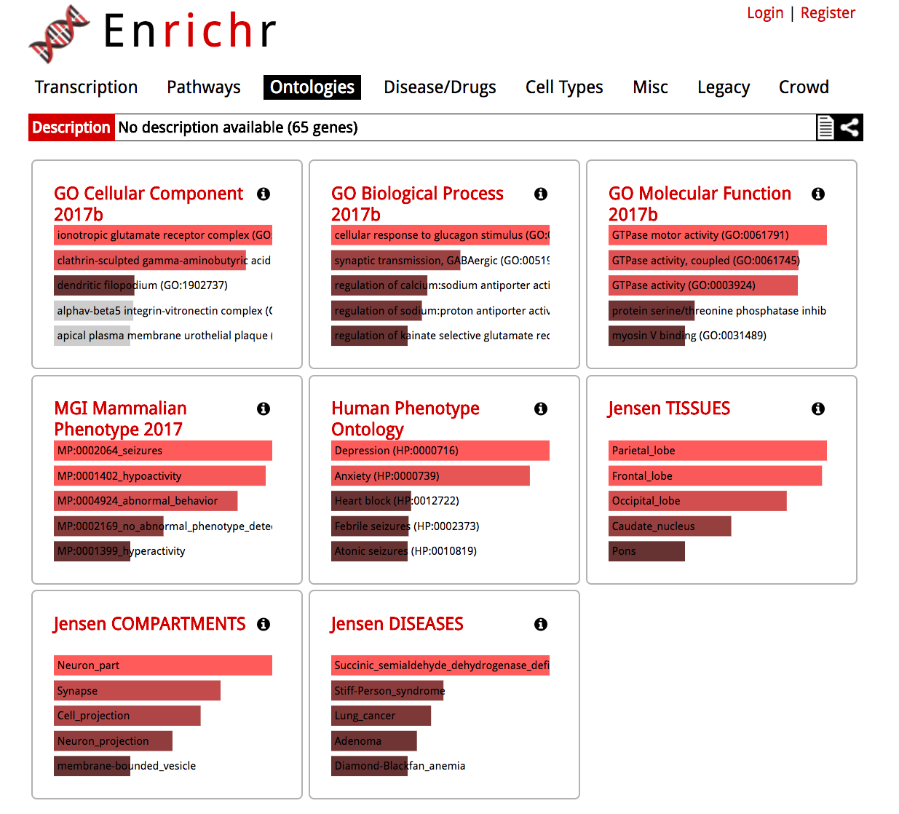
Enrichr

Slide 23
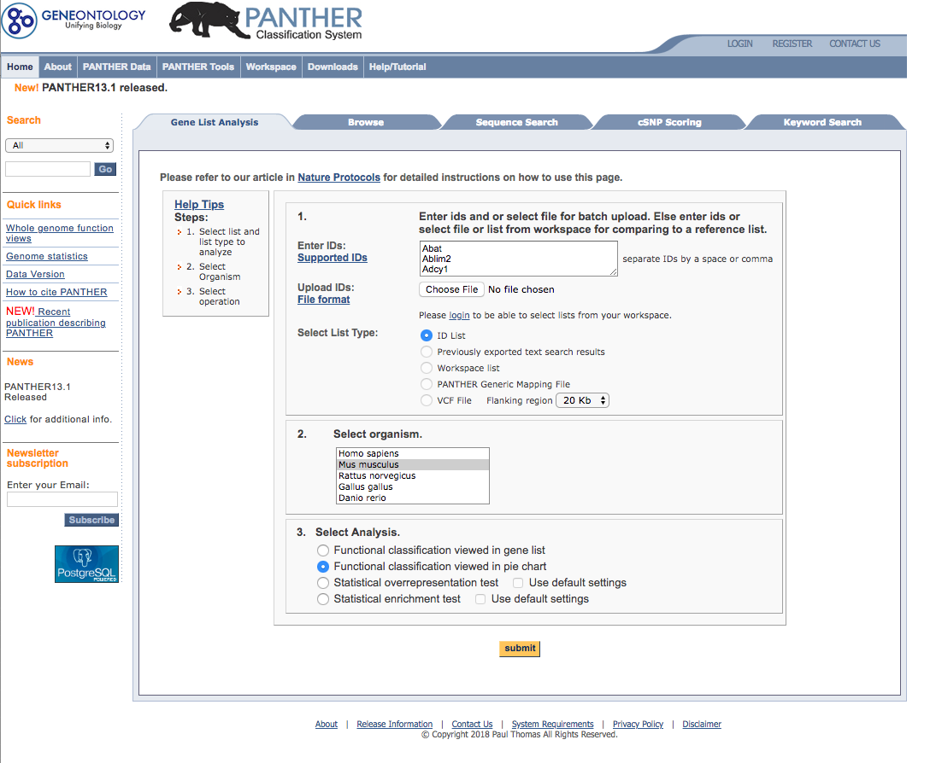
Panther: Submitting Gene List
Paste Gene list
Choose Species
E.g. Mouse
Select Analysis Type
e.g. Pie Chart

Slide 24
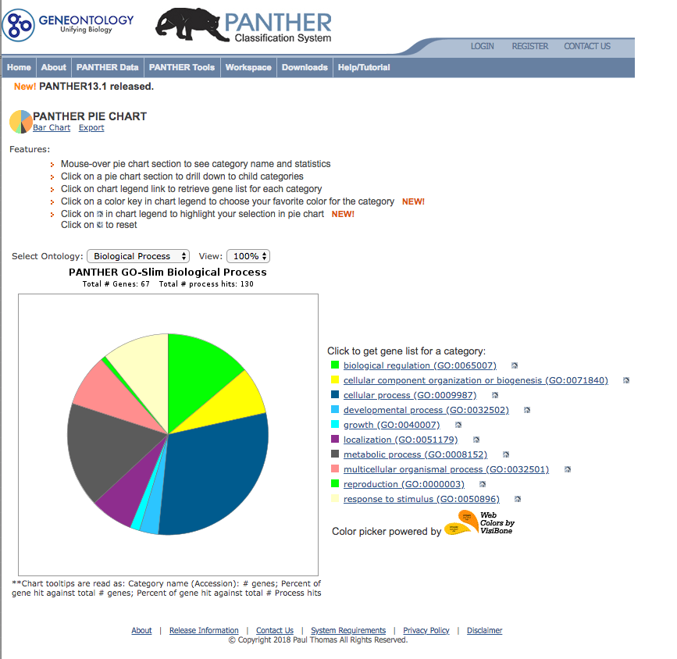
Panther

Slide 25
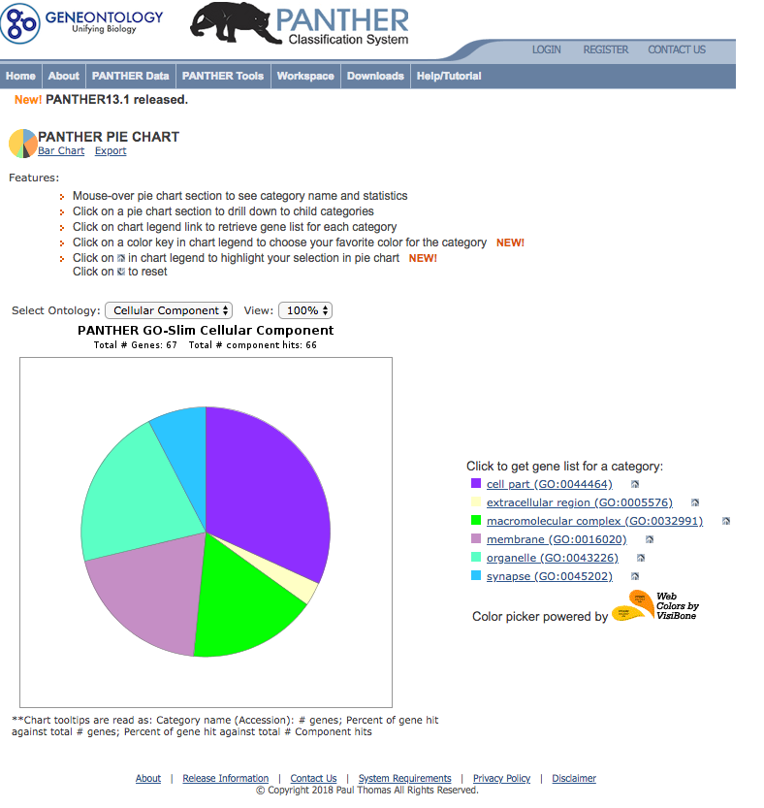
Panther

Slide 26
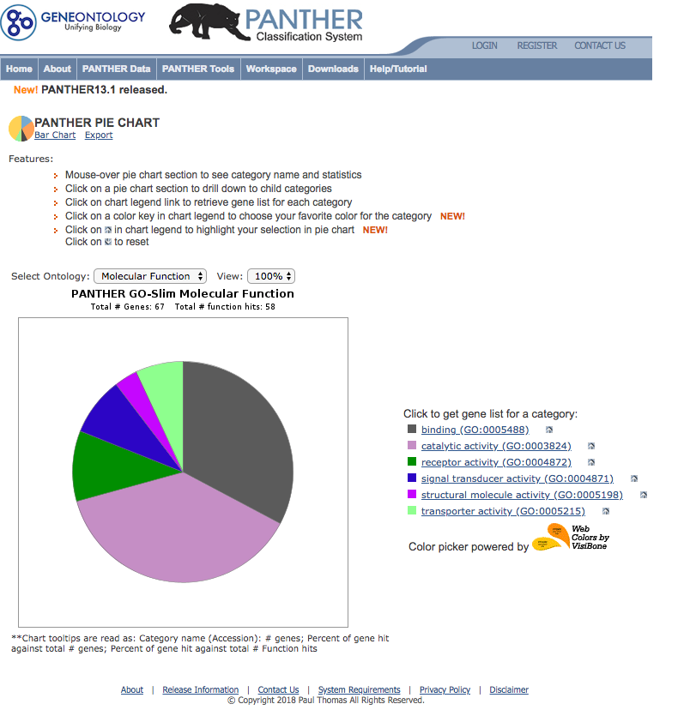
Panther

Slide 27
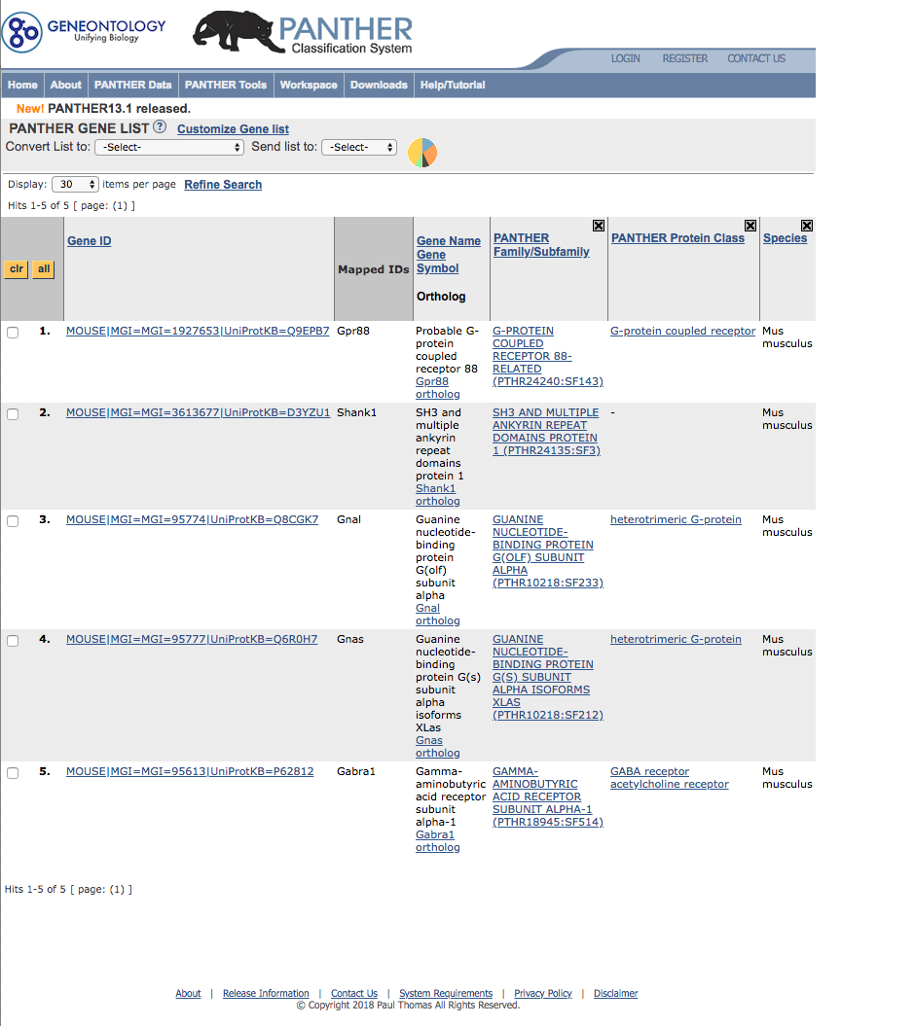
Panther

Slide 28
R
source("https://bioconductor.org/biocLite.R")
biocLite("AnnotationDbi")
biocLite("org.Mm.eg.db")
biocLite("edgeR")

Slide 29
R Goana
library("AnnotationDbi")
library("org.Mm.eg.db")
library(edgeR) ## For goana
## Read GeneList file
DIR <- "/Users/kumarpa/Desktop/Work/KUL/MyPub/Presentations/Jax/Others"
setwd(DIR)
DGEs <- read.table(paste0("GeneList.txt"),header=T,as.is=T); head(DGEs); dim(DGEs)
rownames(DGEs) <- DGEs$Genes; head(DGEs); dim(DGEs)
## Map GeneIDs
DGEs$entrez = mapIds(org.Mm.eg.db, keys=row.names(DGEs), column="ENTREZID", keytype="SYMBOL", multiVals="first"); head(DGEs)
## GO using Goana
go <- goana(as.vector(DGEs$entrez), geneid = rownames(DGEs), species="Mm")
GoanaBP <- topGO(go, n=20,ontology = c("BP")); GoanaBP
GoanaMF <- topGO(go, n=20,ontology = c("MF")); GoanaMF
GoanaCC <- topGO(go, n=20,ontology = c("CC")); GoanaCC
write.table(GoanaCC,file=paste0("Goana.GO_CC_for_DGEsOnly.Top20.txt"),row.names=T,quote=F,sep="\t")
keg <- kegga(as.vector(DGEs$entrez), species="Mm")
GoanaKEGG <- topKEGG(keg, n=20, truncate=20); GoanaKEGG
write.table(GoanaKEGG,file=paste0("Goana.GO_KEGG_for_DGEsOnly.Top20.txt"),row.names=T,quote=F,sep="\t")

Slide 30
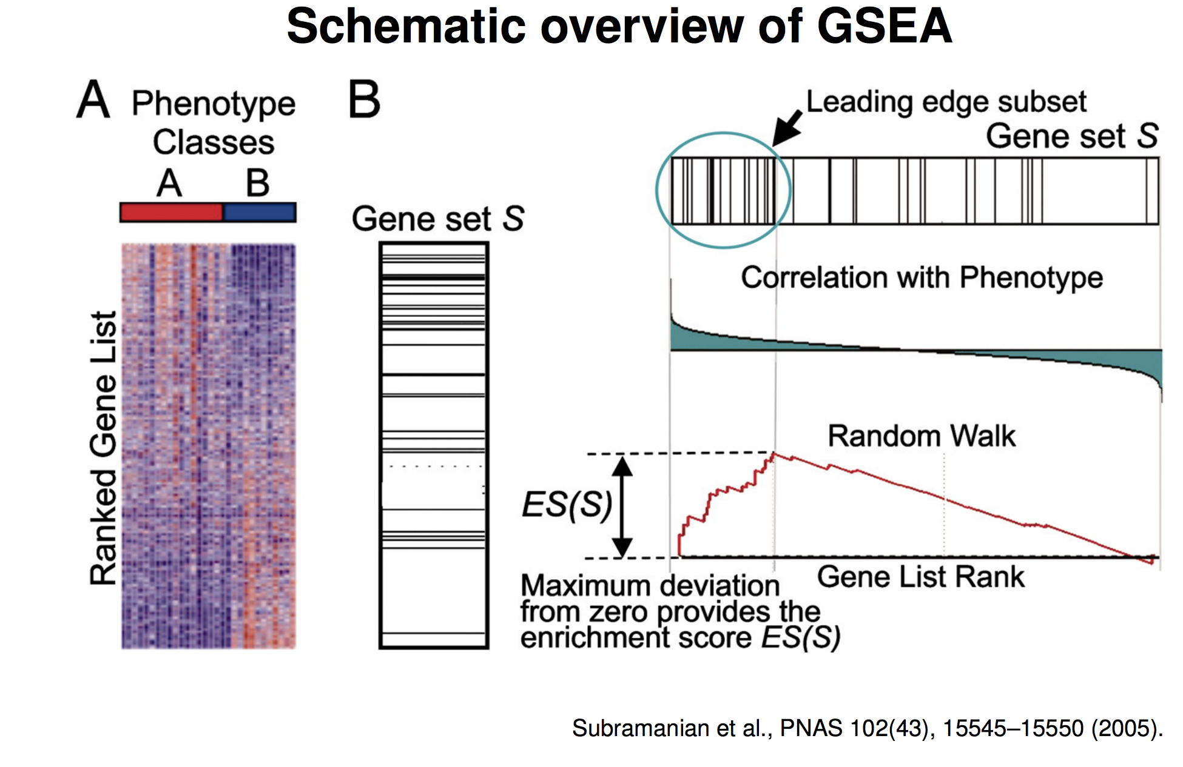
Gene Set Enrichment Analysis
determines whether pre-defined set of genes shows statistically significant, concordant differences between two biological states
resolves the problem of the undetectable, small changes in the expression of single genes

Slide 31
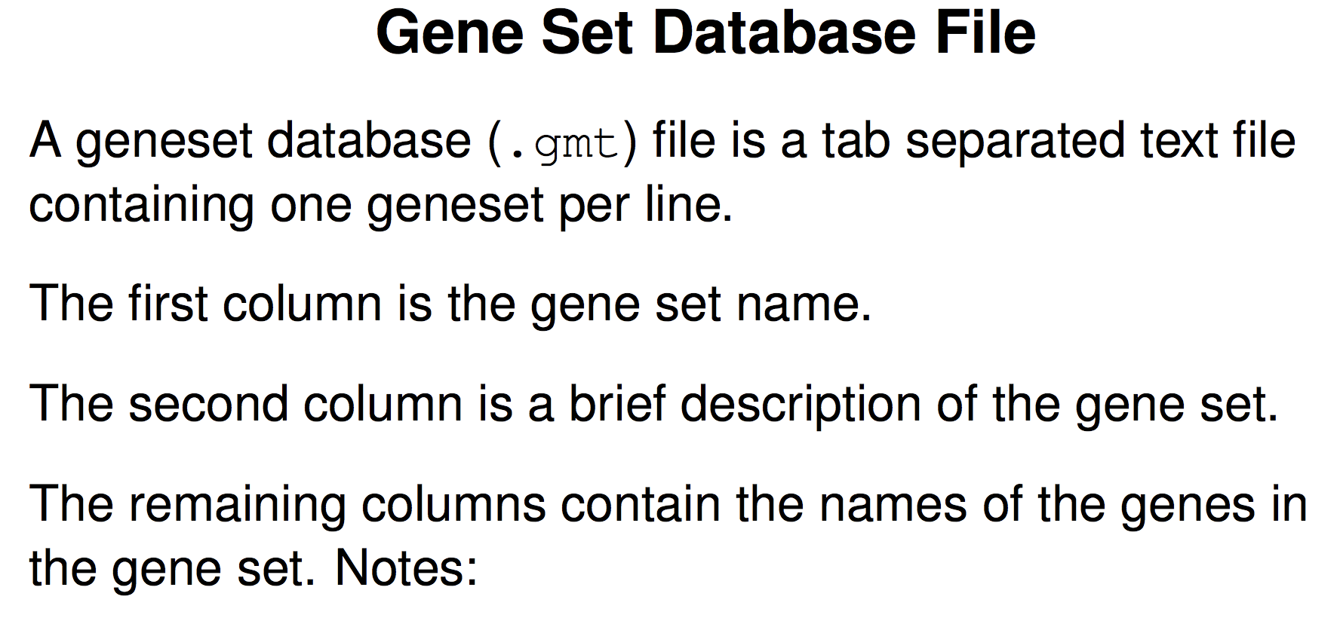
Source: Web

Slide 32
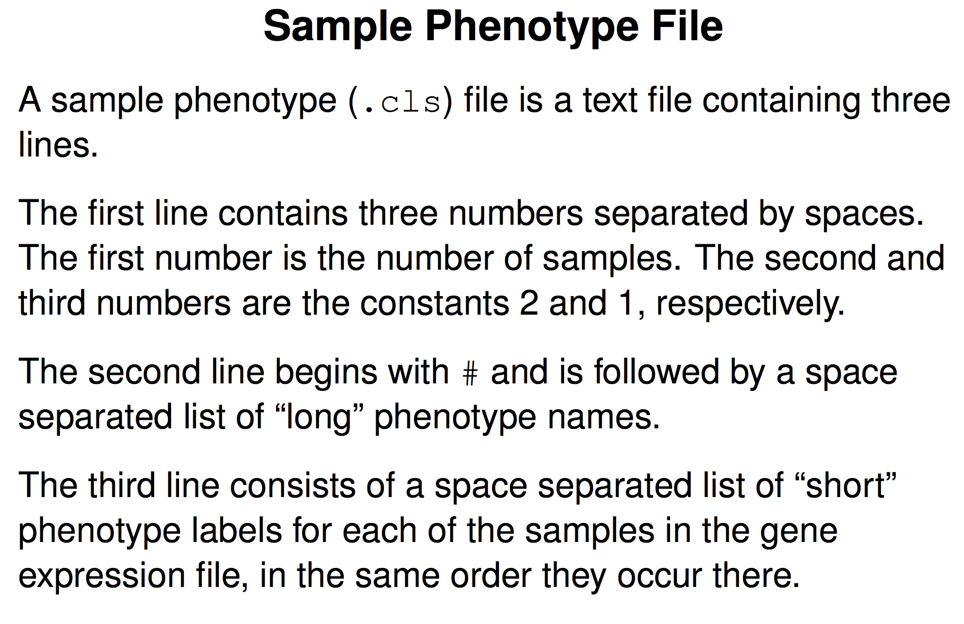
Source: Web

Slide 33
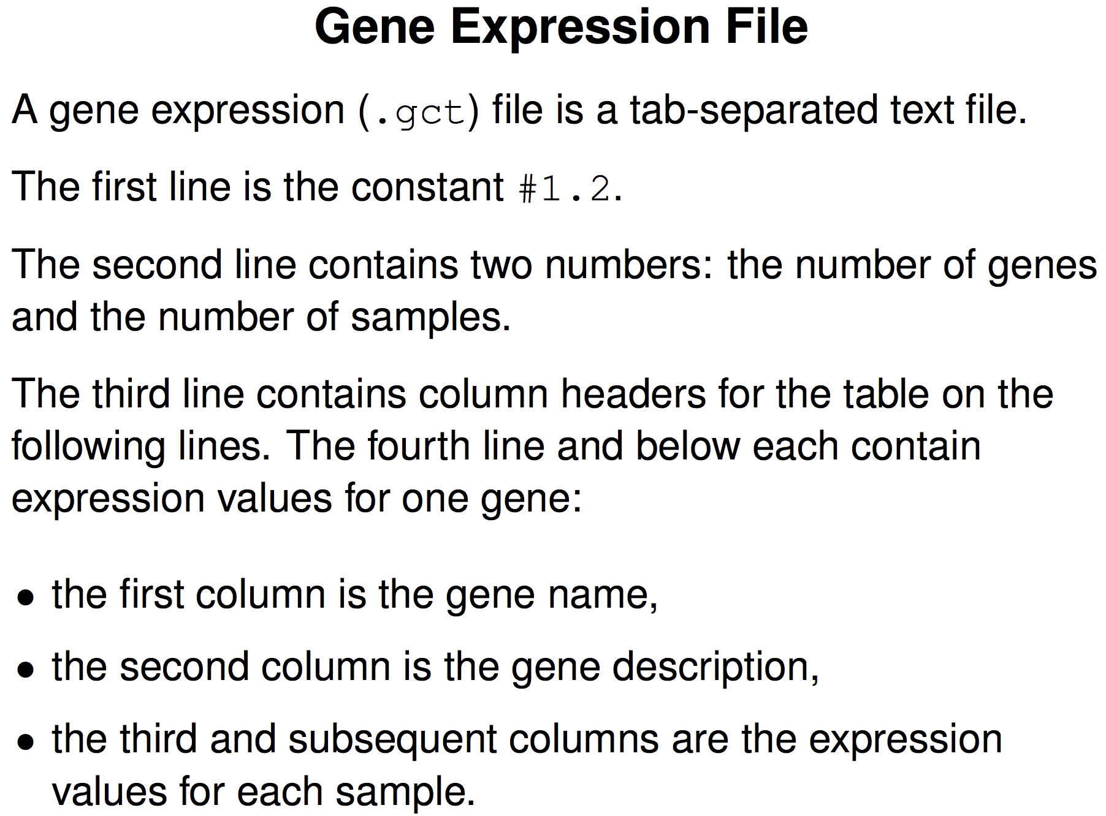
Source: Web

Slide 34
Annotation file (.chip)
The first line contains column headings that identify the content of each column in the remainder of the file. The file must contain three column headings separated by tabs:
Probe Set ID
Gene Symbol
Gene Title

Slide 35
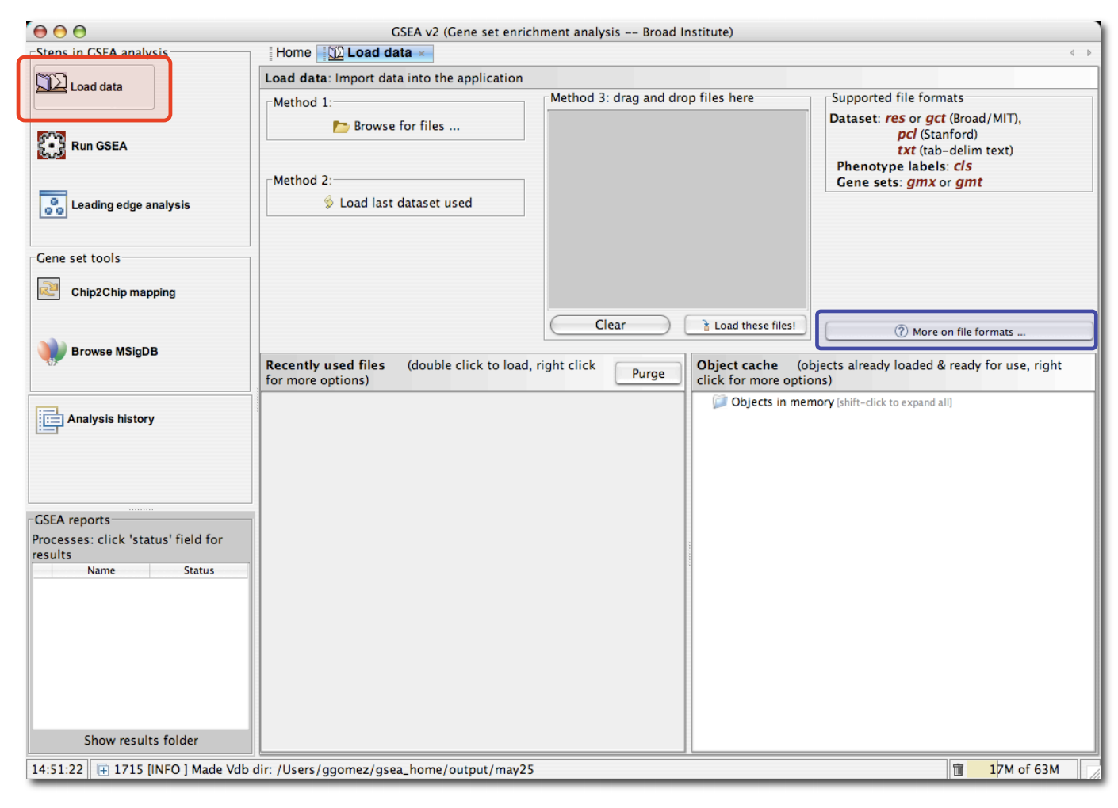
GSEA: Loading Data

Slide 36
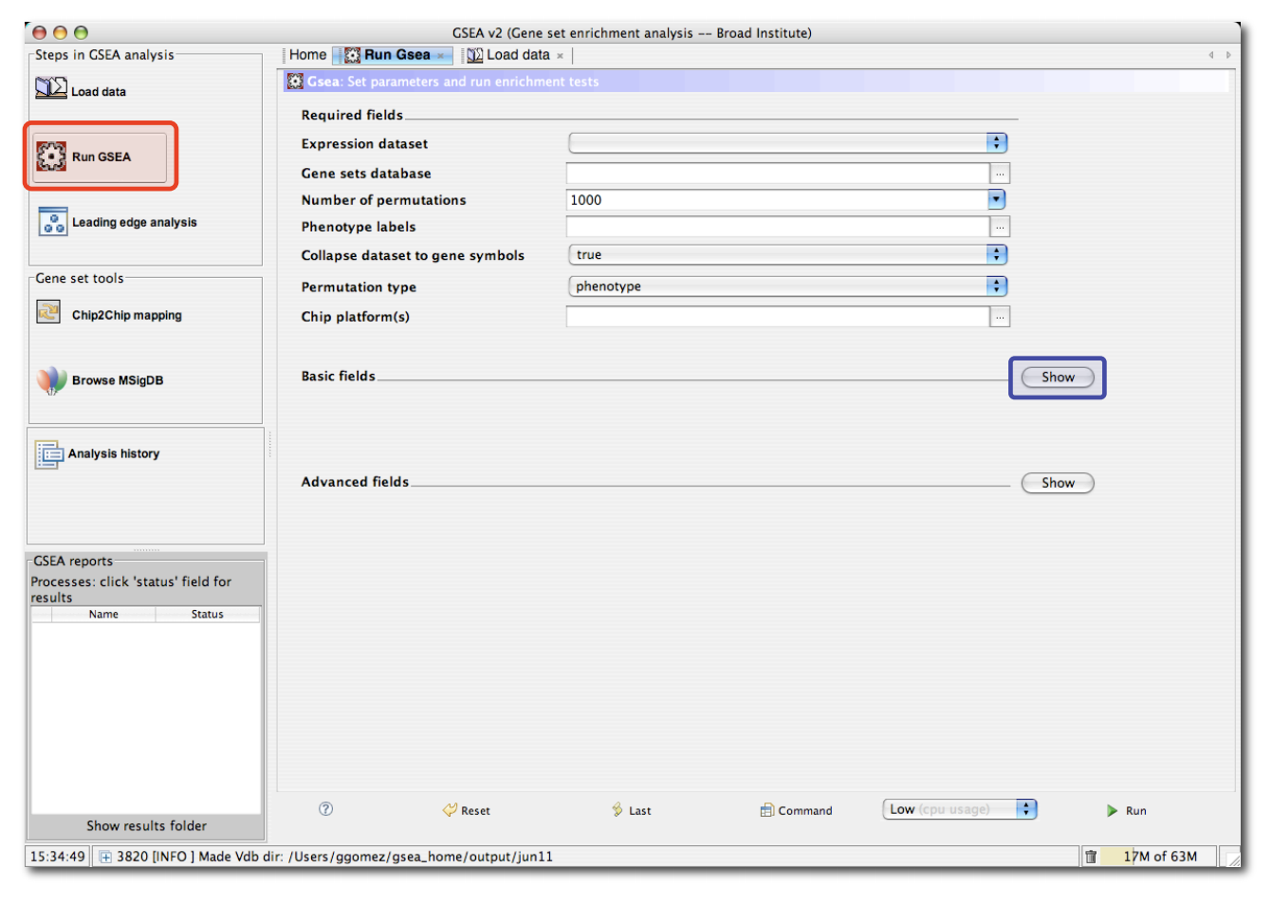
Running GSEA

Slide 37
How to interpret results

Slide 38
Thanks

